Slide 1


Your guiding light to innovation

Slide 2
Quarkus on K8s
Onur Kasimlar

Slide 3

TBT

Slide 4













POSEDIO GMbH
Company founded:
2020
Locations:
Vienna
Vorarlberg
Co-workers:
17 Cloud experts

Slide 5




Services
Cloud Platform
Cloud-Native Consulting
Data Platform
Application Modernization
Multicloud
FinOps
Automated self-service Platform
Security Review
Cloud readiness Review
Architecture Review
Data Governance
Big Data
Data Accessibility
Security and Governance
Scalability & Cost optimization
DevOps

Slide 6
AGENDA
INTRODUCTION QUARKUS
INTEGRATION WITH KUBERNETES

Slide 7
Introduction Quarkus
1

Slide 8
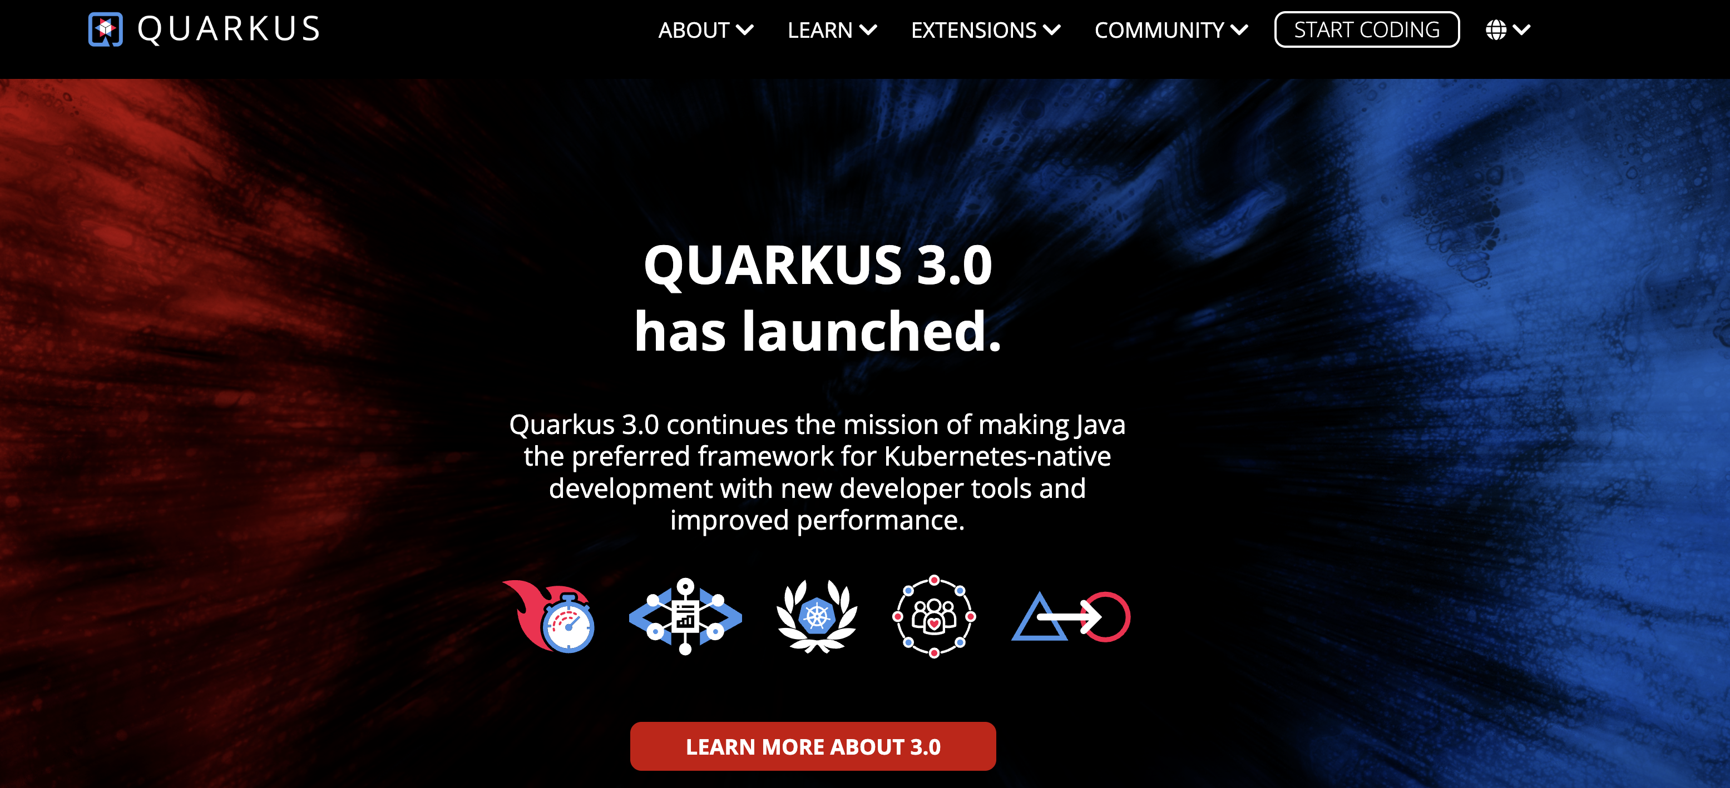
Introduction quarkus
Homepage: https://www.quarkus.com

Slide 9
Introduction quarkus
What is Quarkus?
Open-source framework for developing cloud-native Java applications
Improve performance of Java applications
Enhance the productivity of Java developers

Slide 10
Introduction quarkus
Improve performance of Java applications
Low startup times, low memory usage
AOT (ahead-of-time) compilation

Slide 11
Introduction quarkus
Everything new?
Builds on top of proven standards:
Eclipse MicroProfile
Vert.x
JAX-RS

Slide 12
Introduction quarkus
Enhance the productivity of Java developers
Wide range of features and extensions
Reactive programming
Microservice support
REST messaging frameworks
Database access
Integration with Kubernetes
https://code.quarkus.io/

Slide 13
Integration with Kubernetes
2

Slide 14
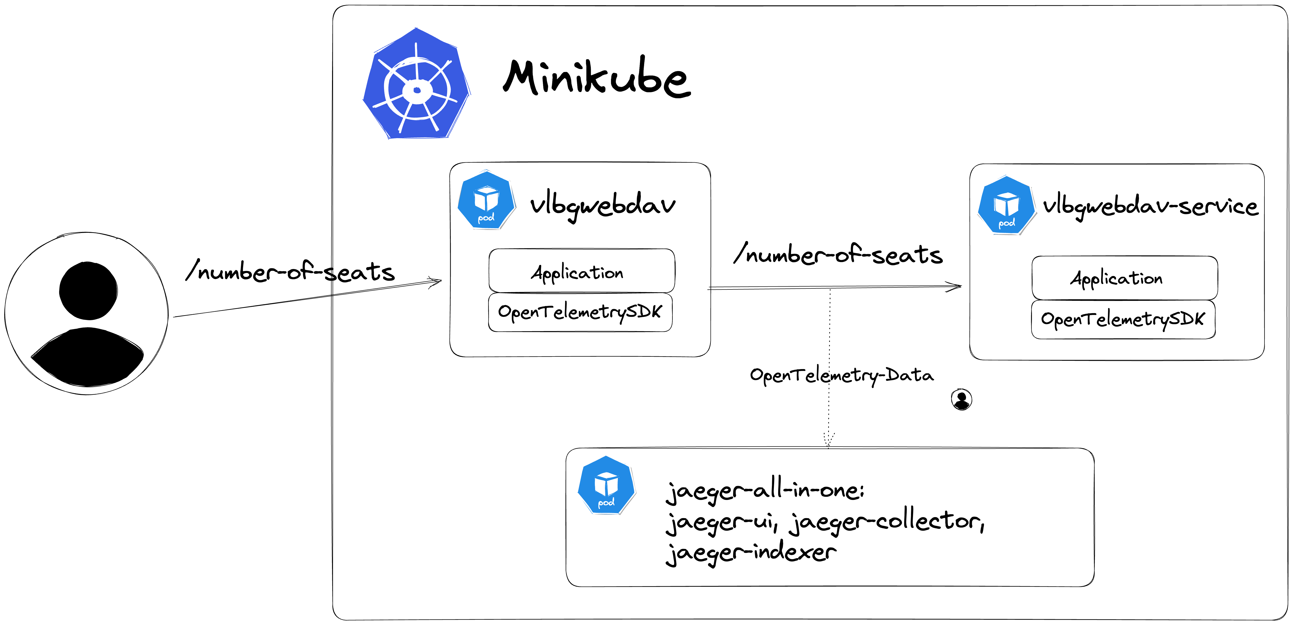
Integration WITH KUBernetes
Example with 2 Microservices

Slide 15
Integration with Kubernetes
What is Kubernetes
Open-source platform for
automating,
deploying,
scaling,
and managing containerized applications.

Slide 16
Integration with Kubernetes
Quarkus basics
Configuration
src/main/application.properties
ConfigMap
Enverionment variables
Staging
With %[stage].[property-name]

Slide 17
Integration with Kubernetes
Quarkus basics
Configuration
src/main/application.properties
ConfigMap
Enverionment variables
Staging
With %[stage].[property-name]

Slide 18
Integration with Kubernetes
Quarkus Kubernetes Features
One-step Kubernetes deployment
Direct Secret and ConfigMap access
Health endpoints
OpenTracing
OpenMetrics
Kubernetes Client Api
….

Slide 19
Integration with Kubernetes
One-step Kubernetes deployment
<dependency> <groupId>io.quarkus</groupId> <artifactId>quarkus-kubernetes</artifactId> </dependency>
<dependency> <groupId>io.quarkus</groupId> <artifactId>quarkus-container-image-docker</artifactId> </dependency>

Slide 20
Integration with Kubernetes
One-step Kubernetes deployment
Generate deployment YAML for Kubernetes Evn.
Service Account, RoleBinding,…
<dependency> <groupId>io.quarkus</groupId> <artifactId>quarkus-kubernetes-minikube</artifactId> </dependency>

Slide 21
Integration with Kubernetes
Direct Secret and ConfigMap access
Read properties from a ConfigMap / Secret
Override application.properties
<dependency> <groupId>io.quarkus</groupId> <artifactId>quarkus-kubernetes-config</artifactId> </dependency>

Slide 22
Integration with Kubernetes
Health Endpoints
Expose application availability and status
Custom application health checks
Built-in health checks
Kafka, JDBC Datasources, Elasticsearch, …
<dependency> <groupId>io.quarkus</groupId> <artifactId>quarkus-smallrye-health</artifactId> </dependency>

Slide 23
Integration with Kubernetes
OpenTracing Support
Distributed Tracing across microservices

Slide 24
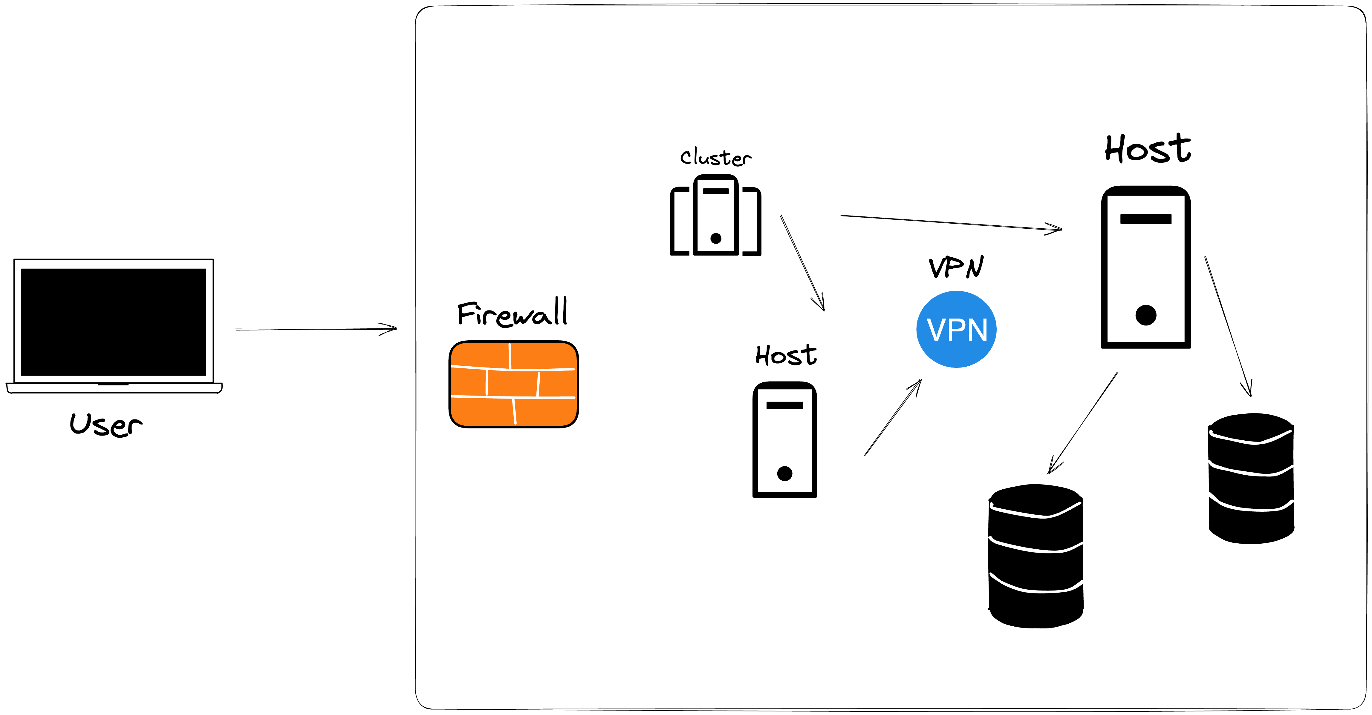
Challenge Distributed Tracing
Example Architecture

Slide 25
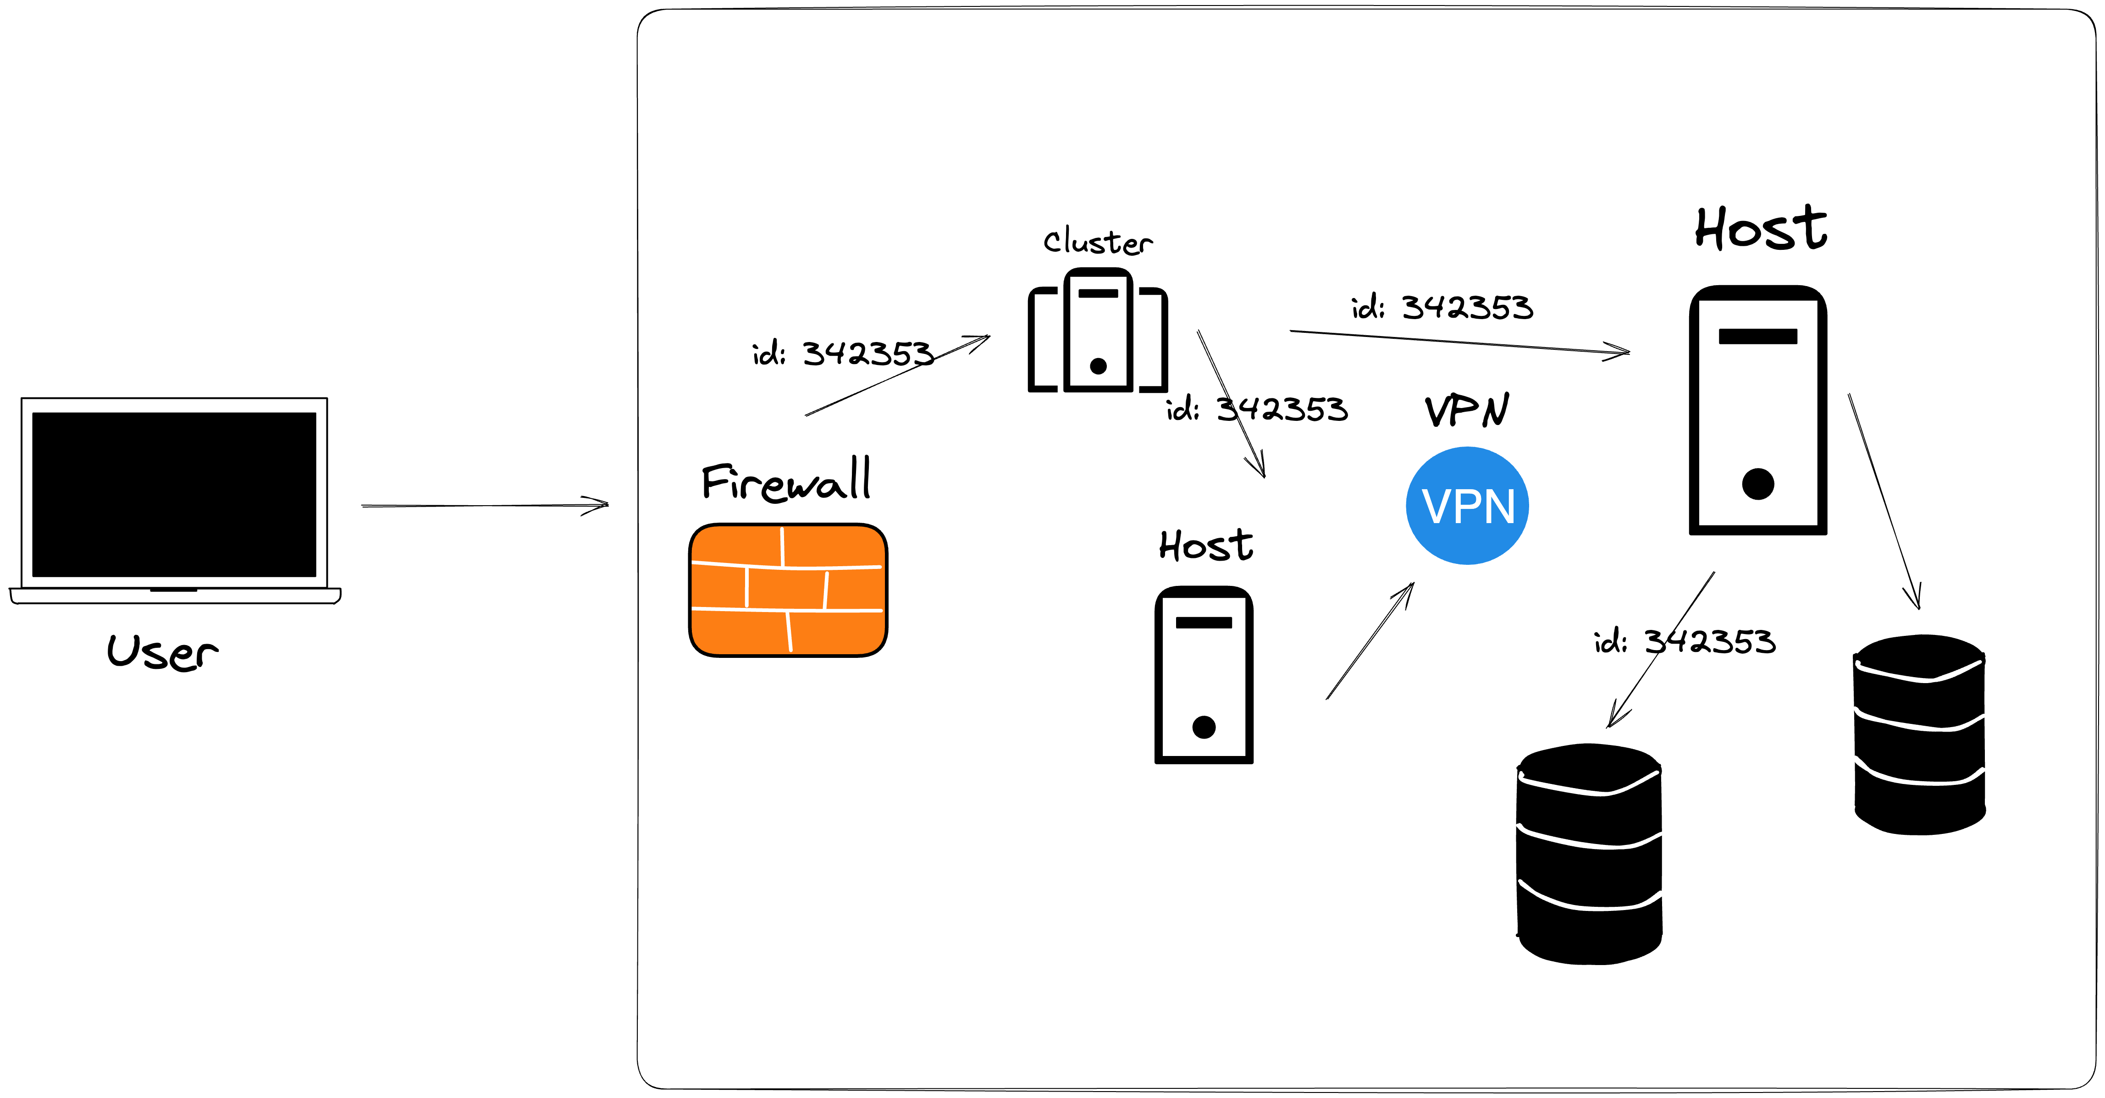
Challenge Distributed Tracing
Example Architecture

Slide 26
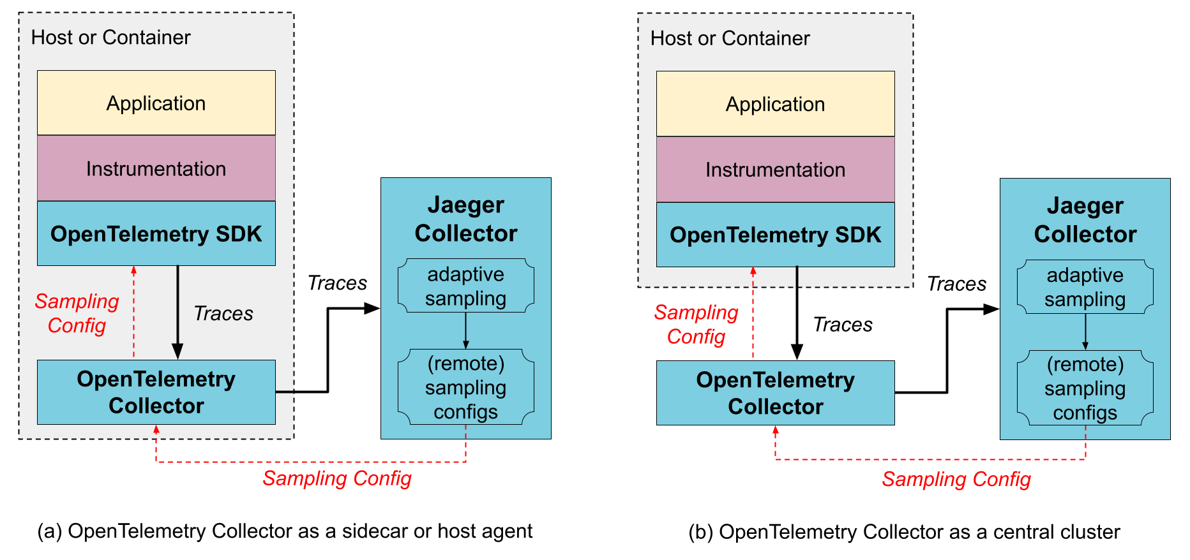
Solution
Architecture

Slide 27
Summary
Quarkus @ K8S
Built for developing cloud-native applications
Improves development performance
Improves memory usage and speed

Slide 28
POSEDIO GMBH
+43 660 9154419
contact@posedio.com
Weyringergasse 1-3, 1040 Wien, Millenium Park 4, 6980 Lustenau
www.posedio.com

